Slide 1



SOCIAL BUZZ ANALYSIS

Slide 2


Today's agenda
Project recap
Problem
The Analytics team
Process
Insights
Summary

Slide 3

Social Buzz is a fast-growing technology unicorn. That needs to adapt quickly to its global scale.
Accenture has begun a 3-month POC focusing on these tasks:
An audit of their big data practice.
Recommendations for a successful IP.
Analysis to find Social Buzz’s top 5 most popular category content.
Project Recap

Slide 4

Problem
Over 100000 posts per day
36,500,000 pieces of content per year!
But how to capitalize on it when there is so much?
Analysis to find Social Buzz’s top 5 most popular category content.

Slide 5



Andrew Fleming (Chief Technical Architect)
The Analytics team
Marcus Rompton (Senior Principle)
Myself
(Data Analyst)

Slide 6
Process
1
Data Understanding
2
Data Cleaning
3
Data Modeling
4
Data Analysis
5
Uncover Insights

Slide 7

Insights
16
1897
January
Unique
categories.
Reaction to ‘animal’ post
The month with most posts.
1
2
3

Slide 8
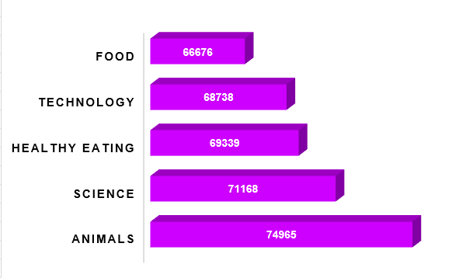
1
The top 5 content categories.

Slide 9
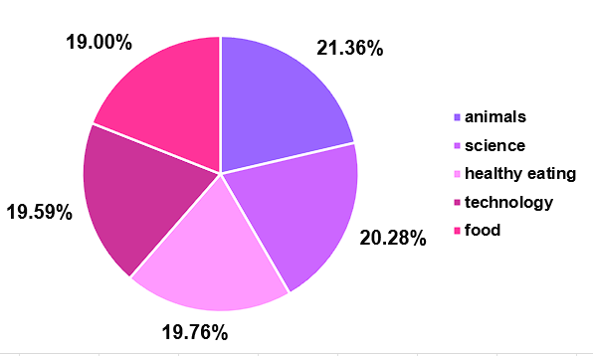
2
Popularity percentage share from top 5 categories.

Slide 10
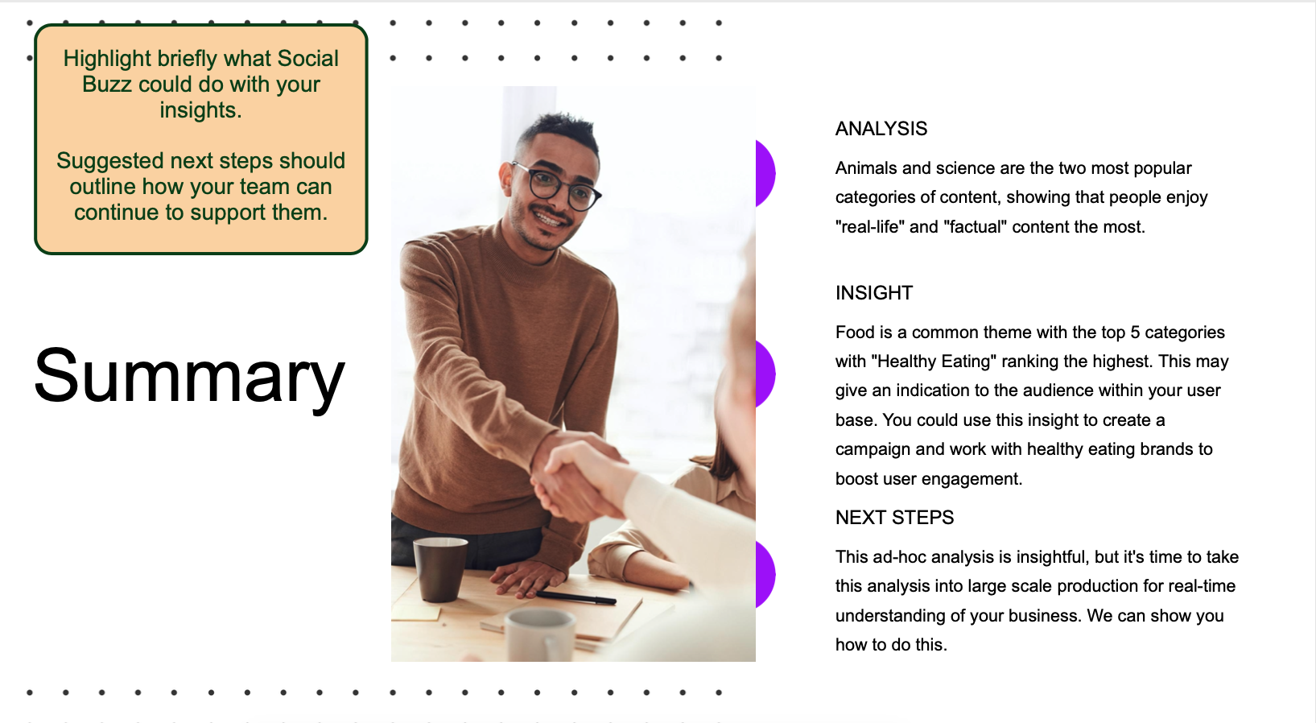

Slide 11
Thank you!
ANY QUESTIONS?

